Slide 1
Modelling and Simulating Social Systems with MATLAB Social discovery and its impact on the spread of infectious diseases
Team Transmissionary
Steffen Arnold, Joris Cadow
December 15, 2015

Slide 2
People discovery
Instance of general social discovery
Personalized recommendations based on users’ preferences
Find new contacts outside of one’s social neighborhood
In some contexts–e.g. dating–new contacts might be short-lived

Slide 3
from http://money.cnn.com/2015/05/26/technology/rhode-island-tinder-stds/

Slide 4
Research questions
Question 1 Can we model the claimed effects?
Question 2 How does people discovery affect the dynamics of a disease? Can these effects be balanced in some way?
Question 3 How does our model relate to existing ones?

Slide 5
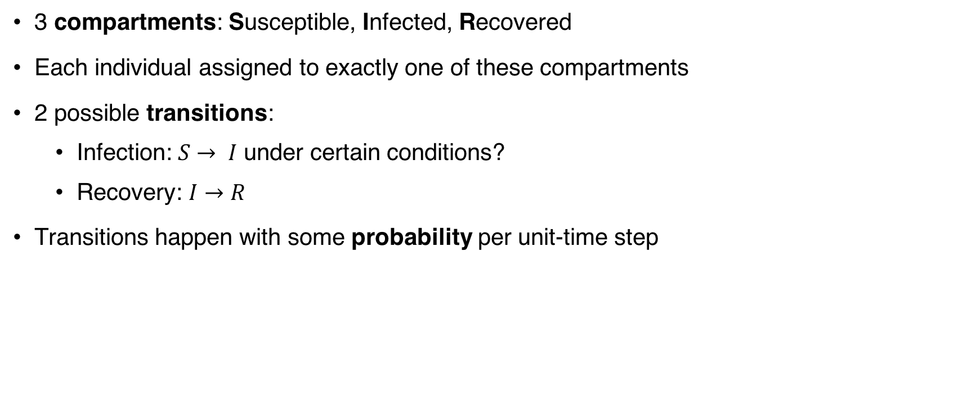
Ingredient 1: epidemiological SIR (1)
3 compartments: Susceptible, Infected, Recovered
Each individual assigned to exactly one of these compartments
2 possible transitions:
Infection: $S→ I$ under certain conditions?
Recovery: $I→R$
Transitions happen with some probability per unit-time step

Slide 6
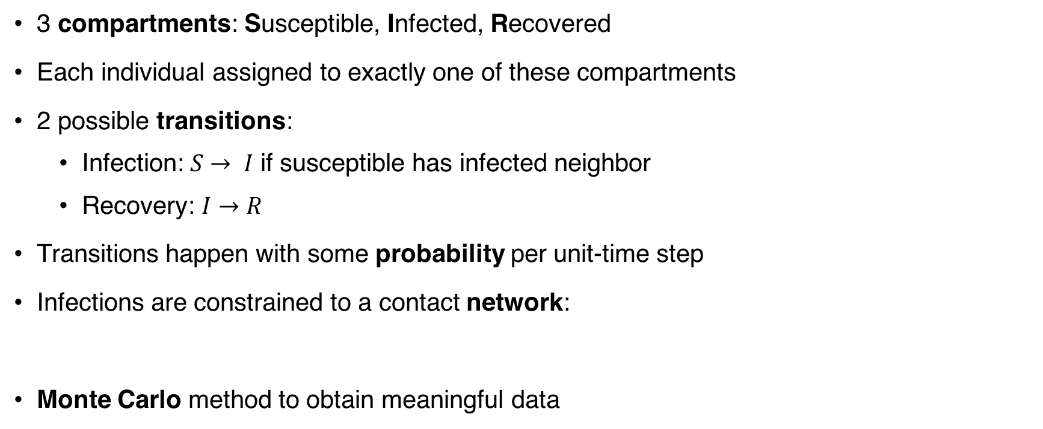
Ingredient 1: epidemiological SIR (2)
3 compartments: Susceptible, Infected, Recovered
Each individual assigned to exactly one of these compartments
2 possible transitions:
Infection: $S→ I$ if susceptible has infected neighbor
Recovery: $I→R$
Transitions happen with some probability per unit-time step
Infections are constrained to a contact network:
Monte Carlo method to obtain meaningful data

Slide 7

Ingredient 2: perturbations
$$t→t+1$$
Again, with some probability per individual and per unit-time step

Slide 8
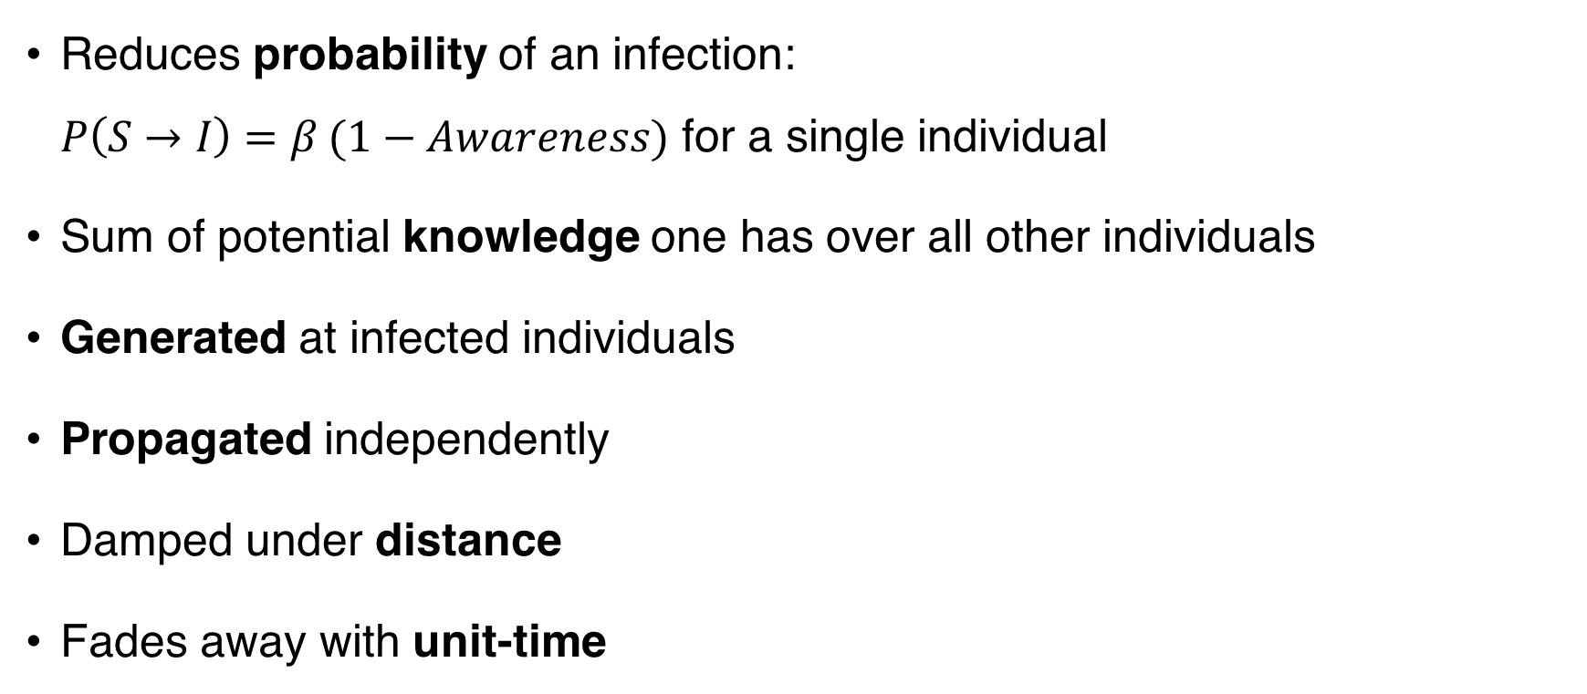
Ingredient 3: awareness
Reduces probability of an infection: $P\left(S→I\right)=β (1−Awareness)$ for a single individual
Sum of potential knowledge one has over all other individuals
Generated at infected individuals
Propagated independently
Damped under distance
Fades away with unit-time

Slide 9
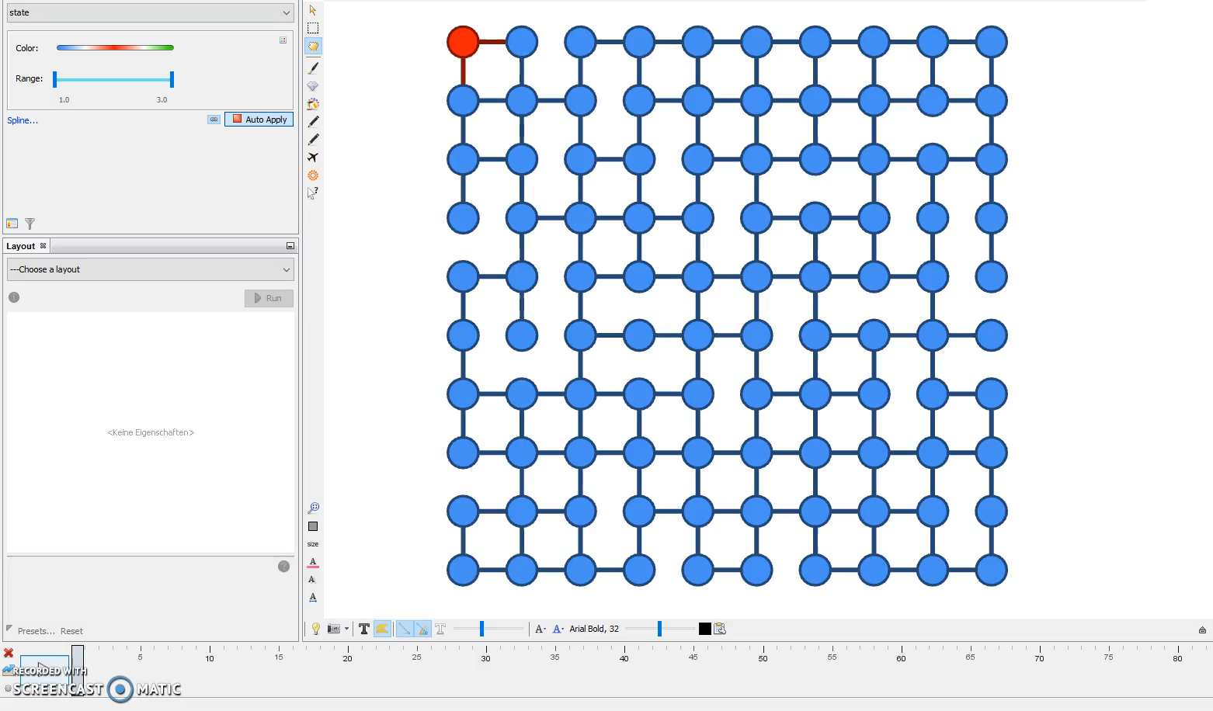
Sample run from our simulations
size of nodes = awareness
color of nodes = SIR state
susceptible – blue
infected – red
recovered – green

Slide 10
SIR plots
More perturbation leads to
more infections
peak of simultaneously infected reached in shorter time
prevalent time in population (generally) shorter
Measure of “epidemic outcome”: # of total infected in last step (= 1 for entire population infected)

Slide 11
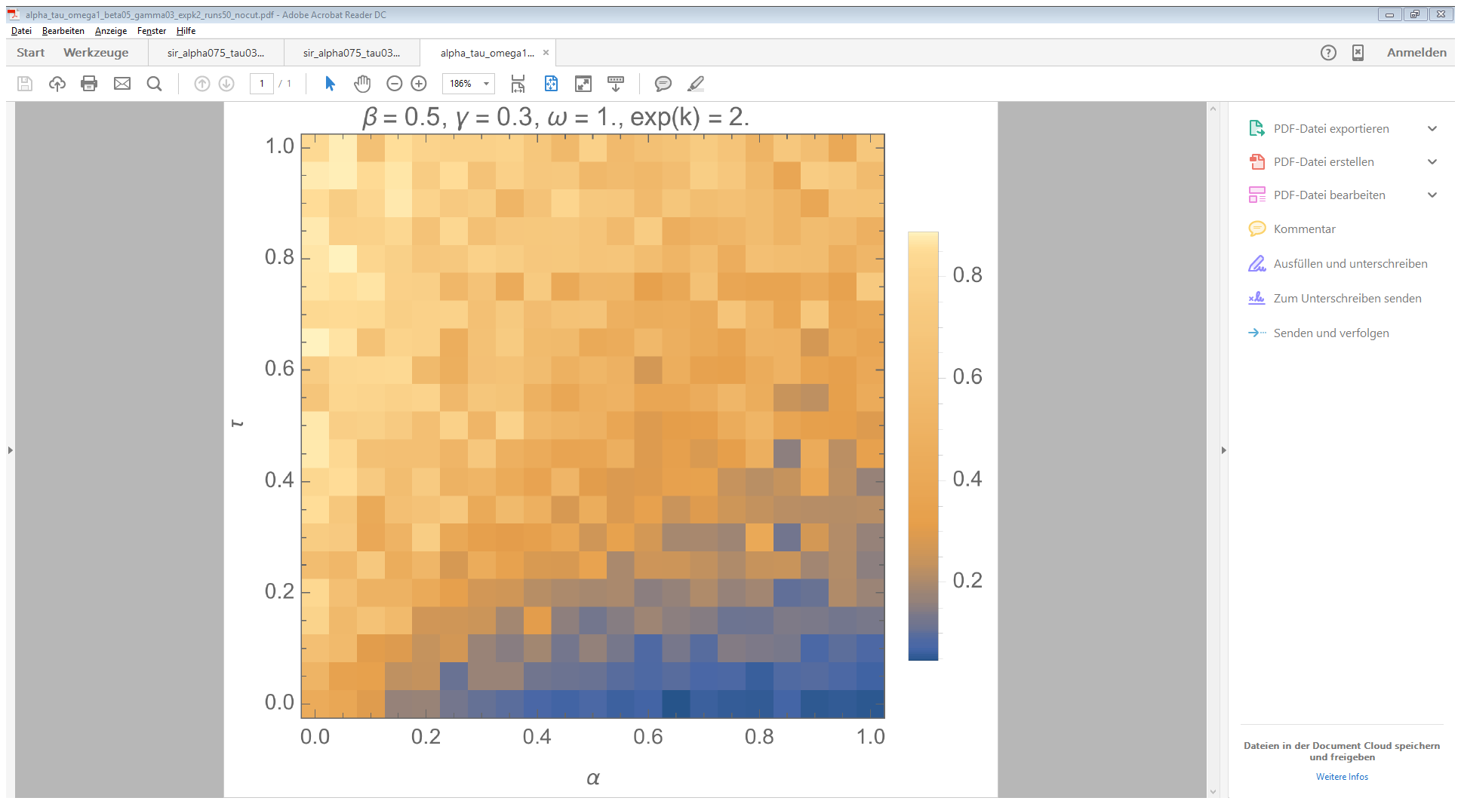
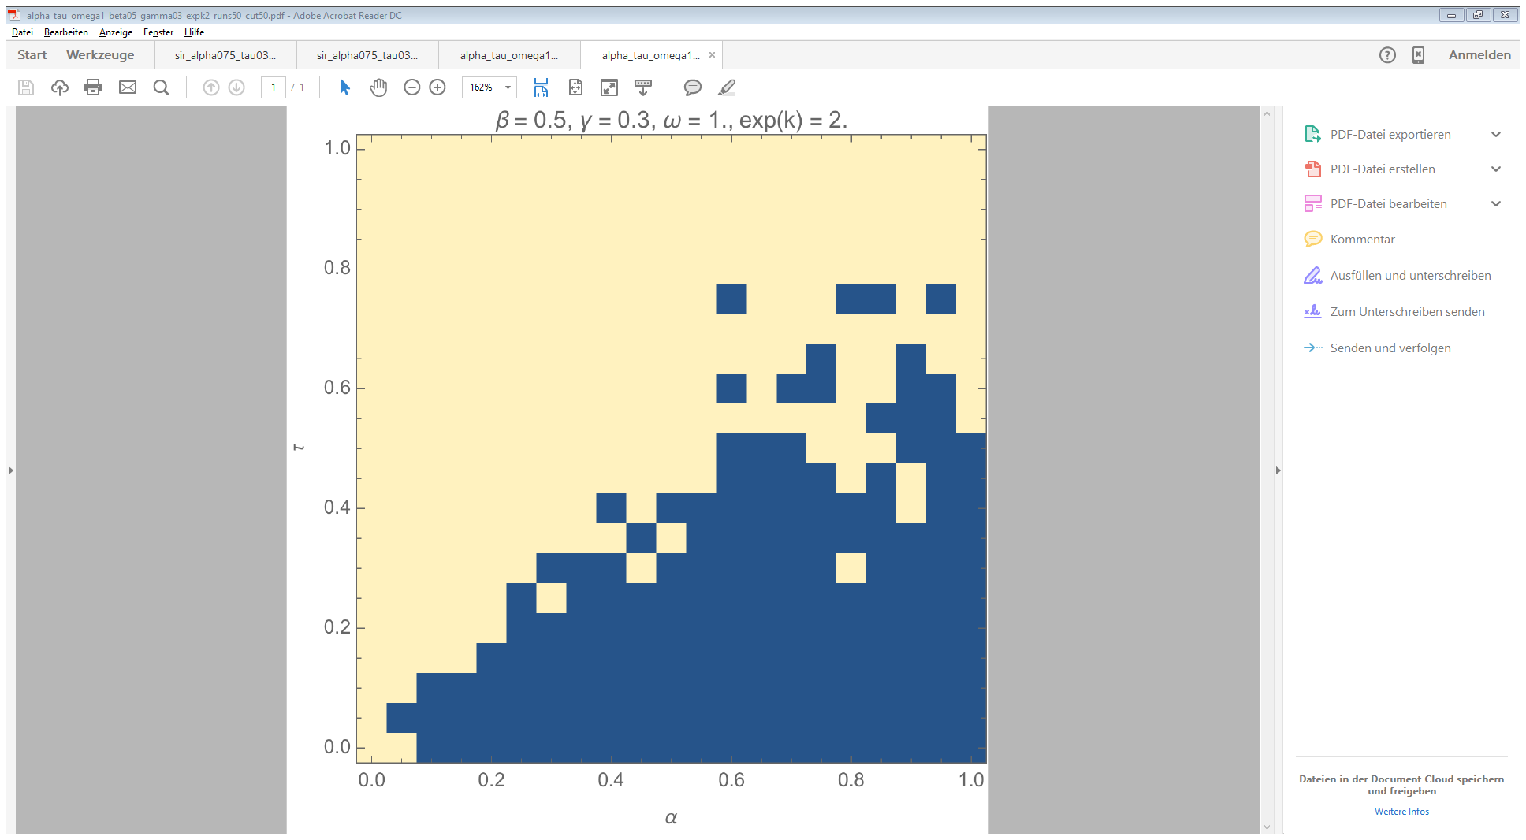
More information can balance more perturbation

Slide 12


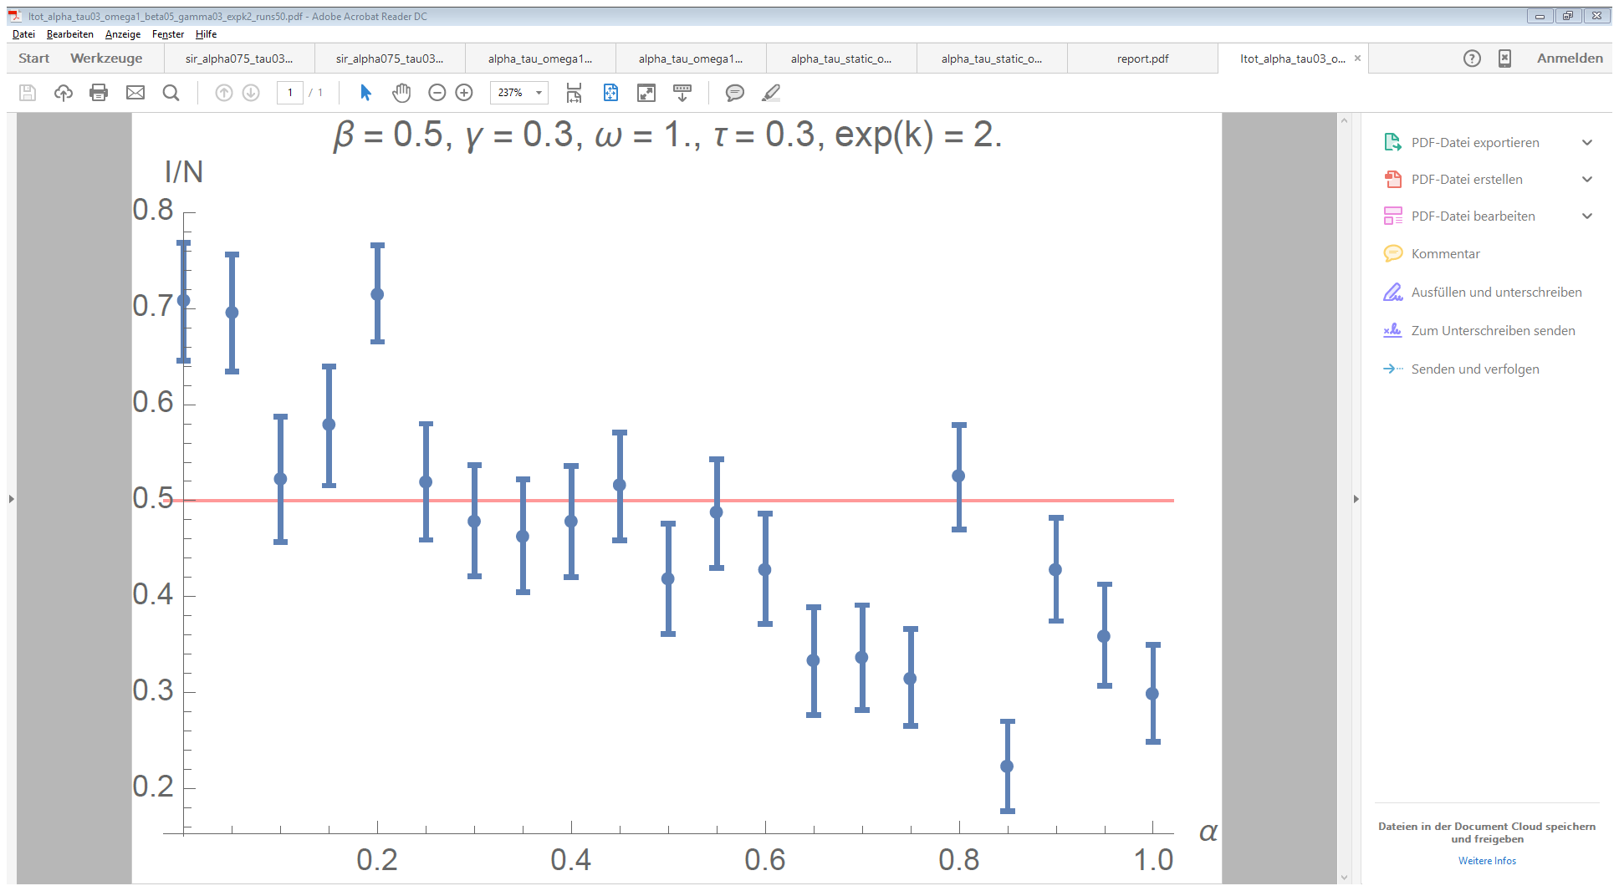
Instability of system

Slide 13
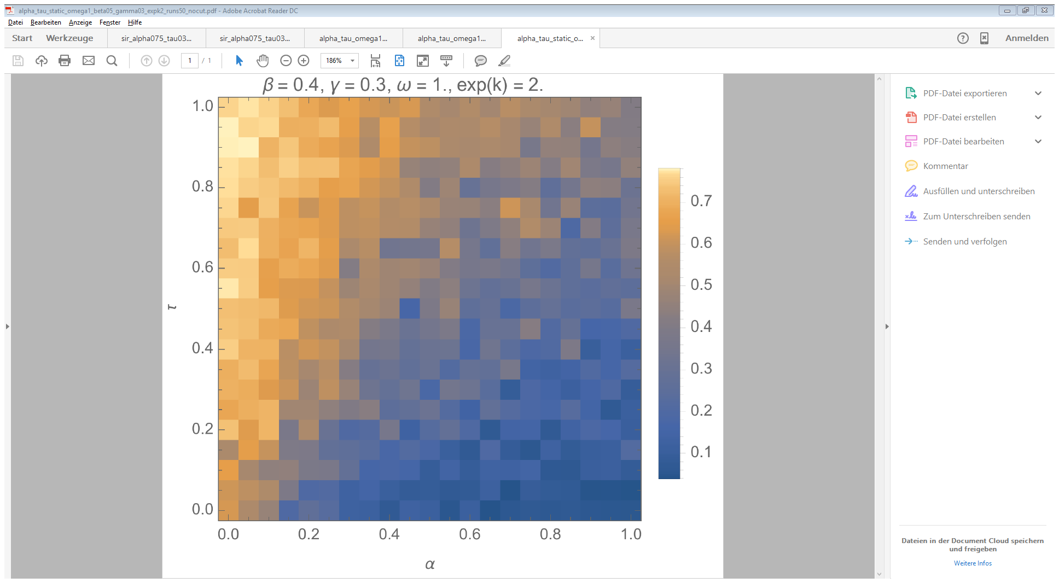
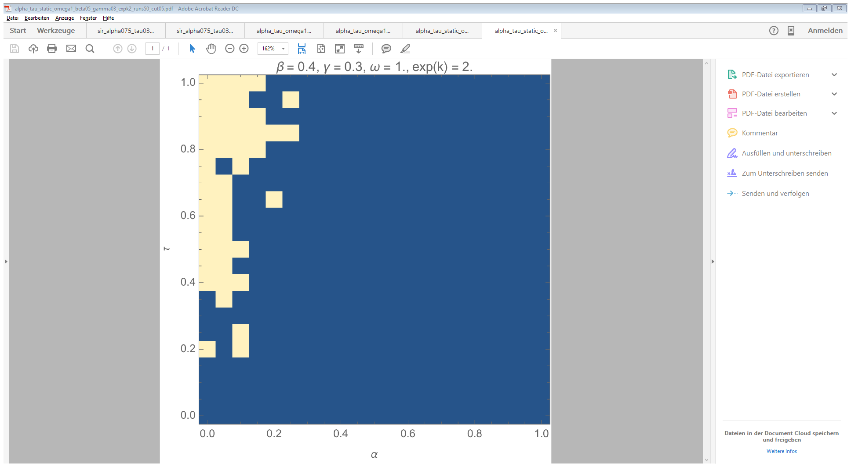
Comparison to divergent but static networks

Slide 14
Implementation & Limitations
Topology: non-periodic grid, 100 nodes, i.e. 10 nodes on each side
Statistics: just 50 runs per parameter set
Perturbations: same probability for each individual, life span of 1 unit-time step
Information generation: always and for sure
Information radius: shortest path length ≤ 3
Decay of awareness: within 2 unit-time steps
Authenticity of awareness: reduced by a factor of 2 for each propagation

Slide 15
Summary & Outlook
Generally more infections when including social discovery (perturbations) and less infections when promoting social distancing (awareness)
Both effects can balance each other but the outcome becomes unstable
Our assumptions need to be relaxed and evaluated, in particular:
Use of more realistic network topologies, after all it is about social discovery
Model asymptomatic time by tuning probability of information generation
Random links should depend on spatial distance and exclude existing neighborhood, and they should reflect a distribution within the population (few individuals making using of social discovery)

Slide 16
References
S. Funk, E. Gilad, C. Watkins, and V. A. Jansen. The spread of awareness and its impact on epidemic outbreaks. Proc Natl Acad Sci U S A, 106(16):6872–7, 2009.
W. O. Kermack and A. G. McKendrick. A Contribution to the Mathematical Theory of Epidemics. Proceedings of the Royal Society of London Series A, 1927.
S. Riley, C. Fraser, C. A. Donnelly, A. C. Ghani, L. J. Abu-Raddad, A. J. Hedley, G. M. Leung, L. M. Ho, T. H. Lam, T. Q. Thach, P. Chau, K. P. Chan, S. V. Lo, P. Y. Leung, T. Tsang, W. Ho, K. H. Lee, E. M. Lau, N. M. Ferguson, and R. M. Anderson. Transmission dynamics of the etiological agent of sars in hong kong: impact of public health interventions. Science, 300(5627):1961–6, 2003.

Slide 17
Questions?

